Slide 1

Case Study Analysis of Myntra Apparel
Presented by
Sayooj R

Slide 2
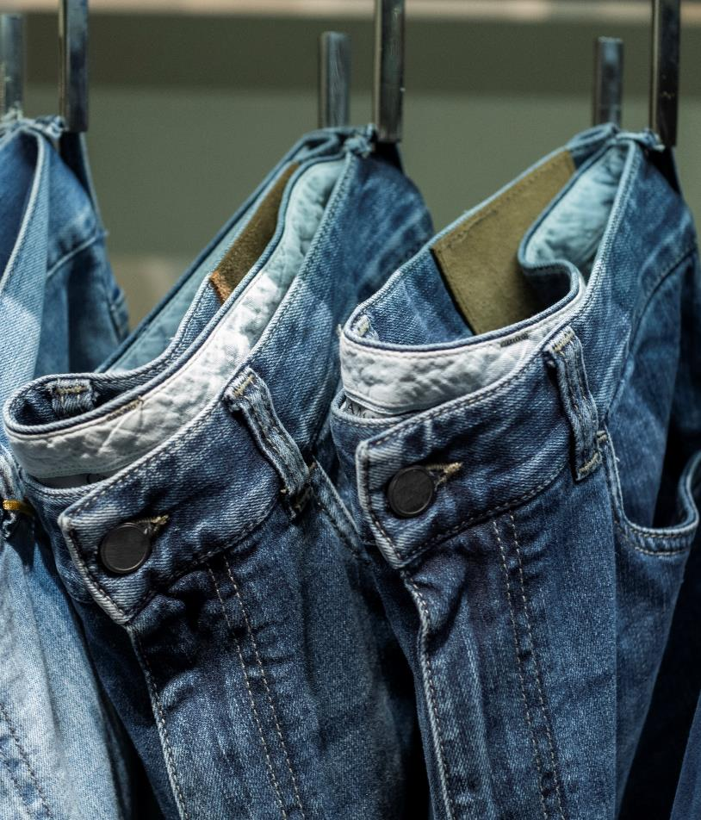
Problem Statement
You are working at Myntra, a leading online fashion retailer. The management has asked you to analyze a dataset of various apparel items to gain insights into pricing, discounts, ratings, and available sizes.

Slide 3

Solutions
Data Cleaning and Preparation
Data Analysis
Data Retrieval and Lookup

Slide 4
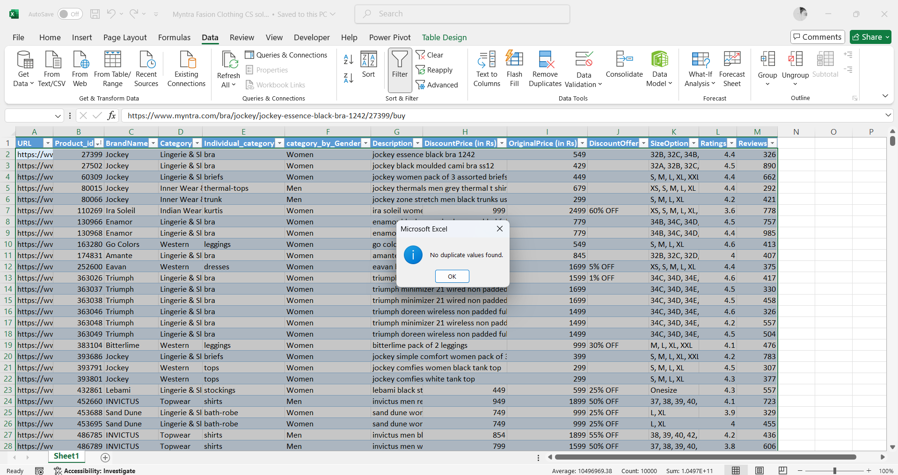
A. Data Cleaning and Preparation
A1. Check for duplicate values in your dataset and remove them.
From ribbon -> Data -> Remove Duplicates
Select unique id, i.e. : Product_id
Result : No duplicates values
Nb : The selection includes only the first 10,000 rows from the original document.

Slide 5
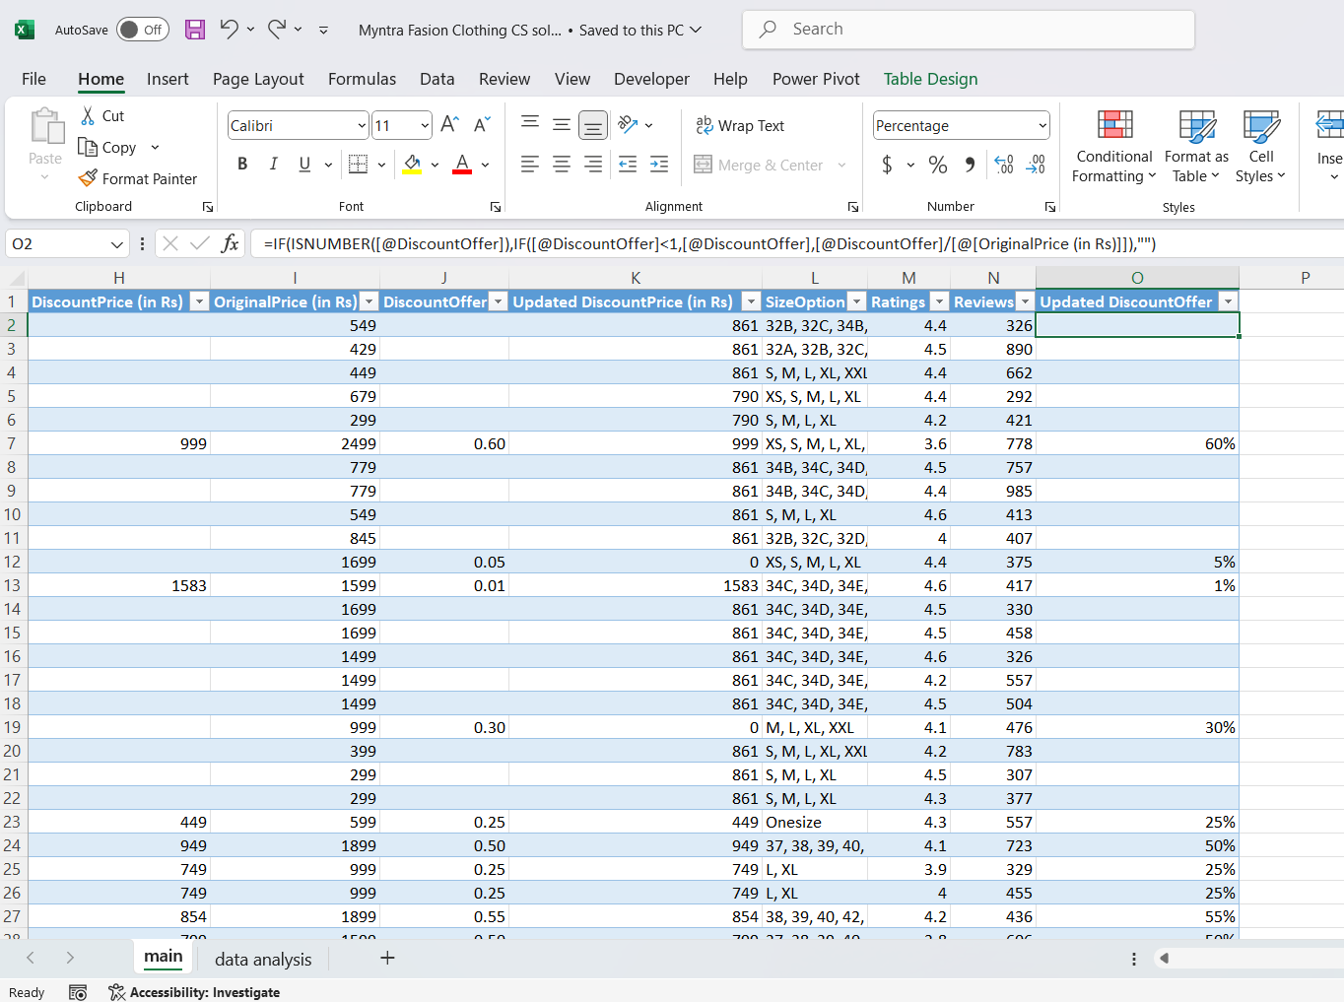
A2. Standardize the "DiscountOffer" column to a single format, ensuring all values are uniform.
cntrl + F -> replace “,* hurry” and “OFF“ with blank.
Select DiscountOffer and change to number from percentage.
Home -> under number section -> scroll down to number.
Take a new column and apply formula to find the required fields.
Change the whole new “Updated DiscountOffer” column back to “percentage” category using the above steps again.
Results : “Updated DiscountOffer”
Nb : The selection includes only the first 10,000 rows from the original document.

Slide 6
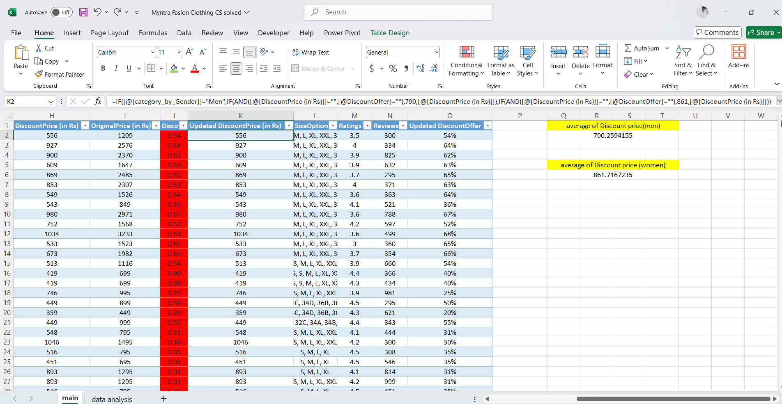
A3. Identify rows where both "Discount Price" and "DiscountOffer" are null and fill the "Discount Price" with the average discount price of the respective category.
Find average discount price of men and women separately.
Identify rows with both null values and dump the avg values respectively.
Result : Updated DiscountPrice
Nb : The selection includes only the first 10,000 rows from the original document.

Slide 7
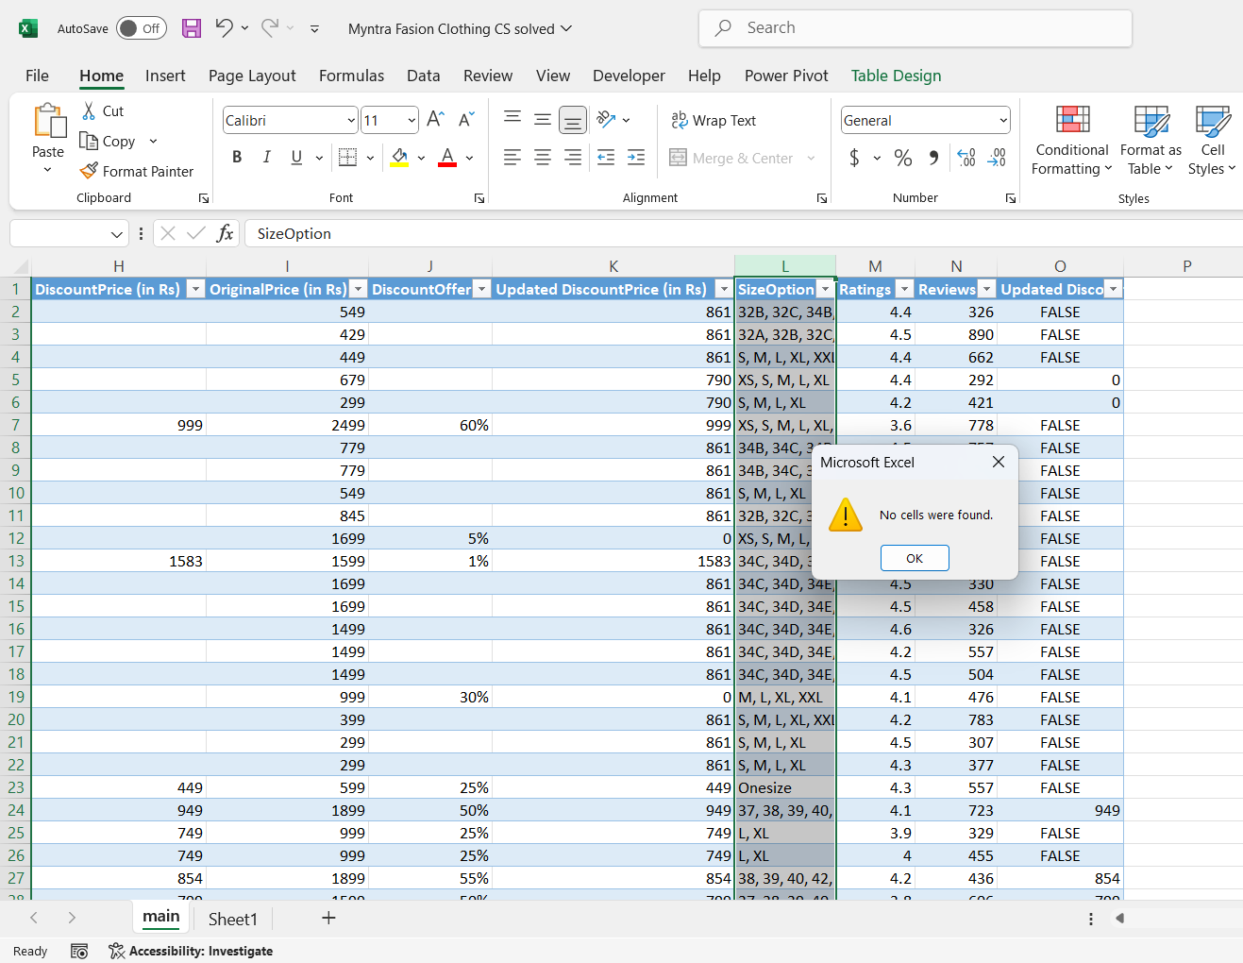
A4. Replace all null values in the "SizeOption" column with the text "Not Available."
From ribbon -> Home -> Find & Select
Select Go to special -> Blanks
Result : No NULL values found.
Nb : The selection includes only the first 10,000 rows from the original document.

Slide 8
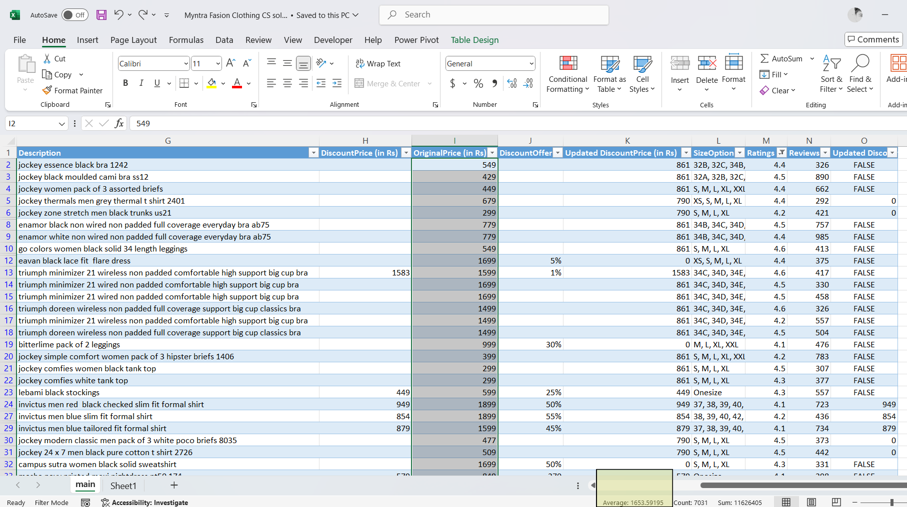
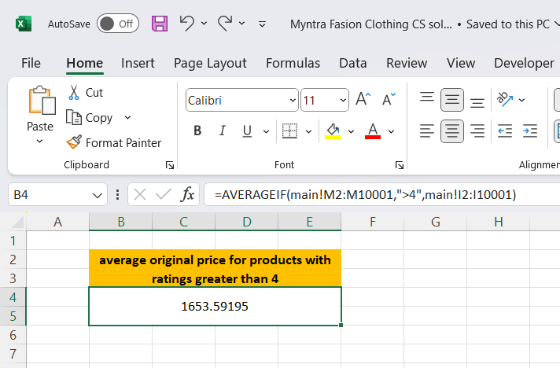
B. Data Analysis
B1. Calculate the overall average original price for products with ratings greater than 4.
Nb : The selection includes only the first 10,000 rows from the original document.

Slide 9
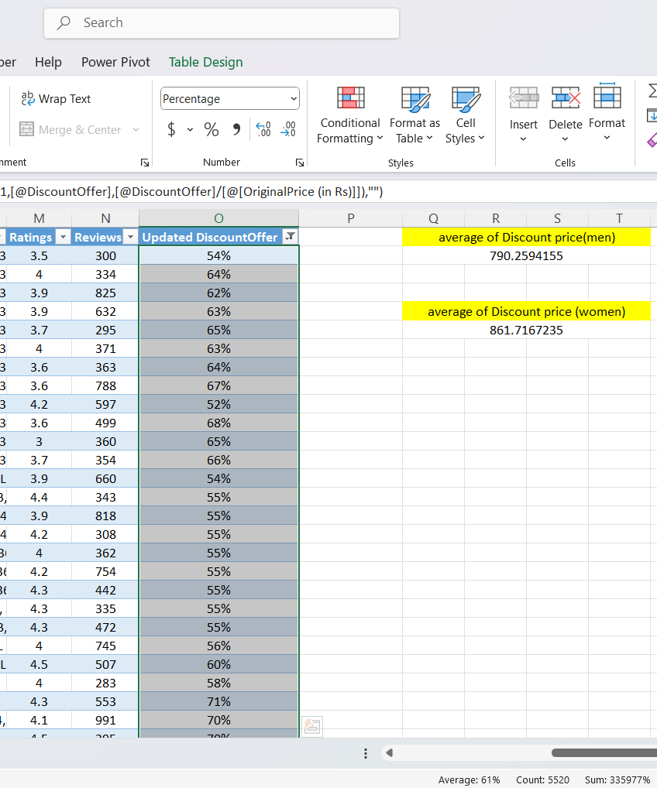
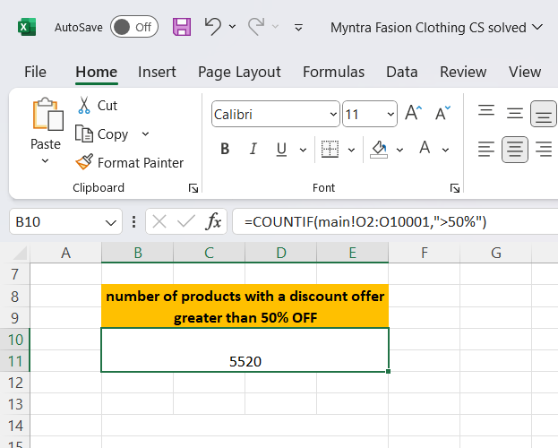
B2. Count the number of products with a discount offer greater than 50% OFF.
Nb : The selection includes only the first 10,000 rows from the original document.

Slide 10
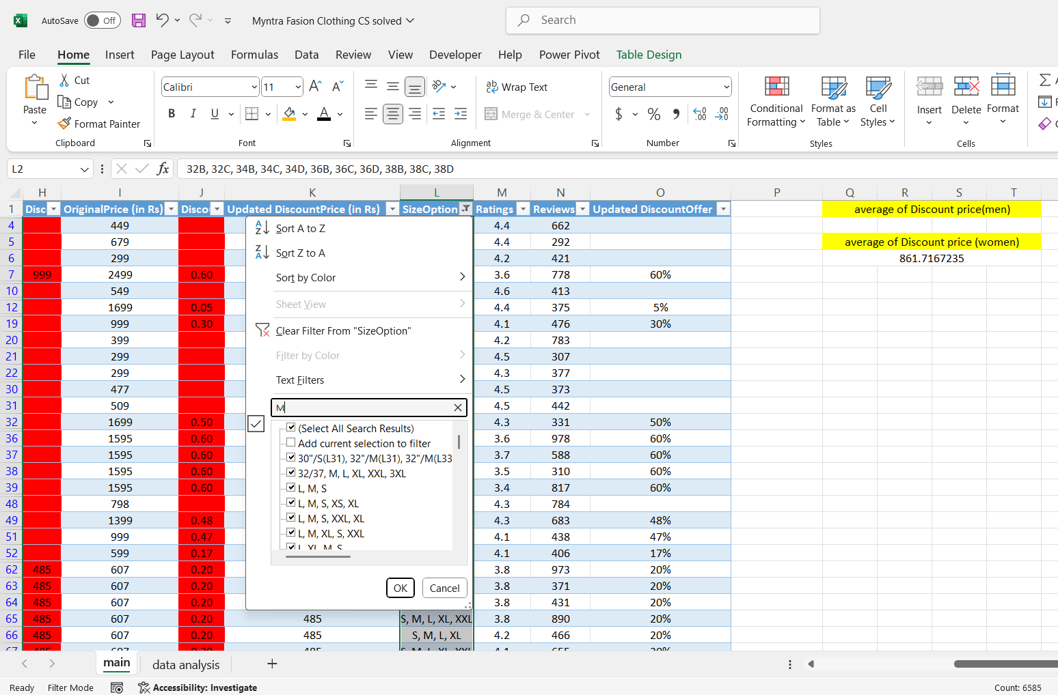
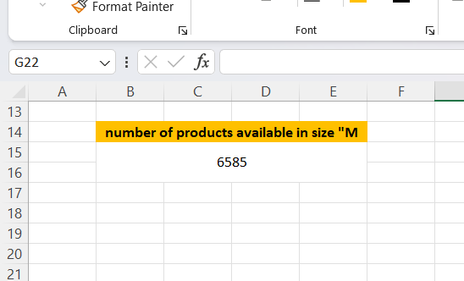
B3. Count the number of products available in size "M."
Filter with “M” and observe the count.
Nb : The selection includes only the first 10,000 rows from the original document.

Slide 11
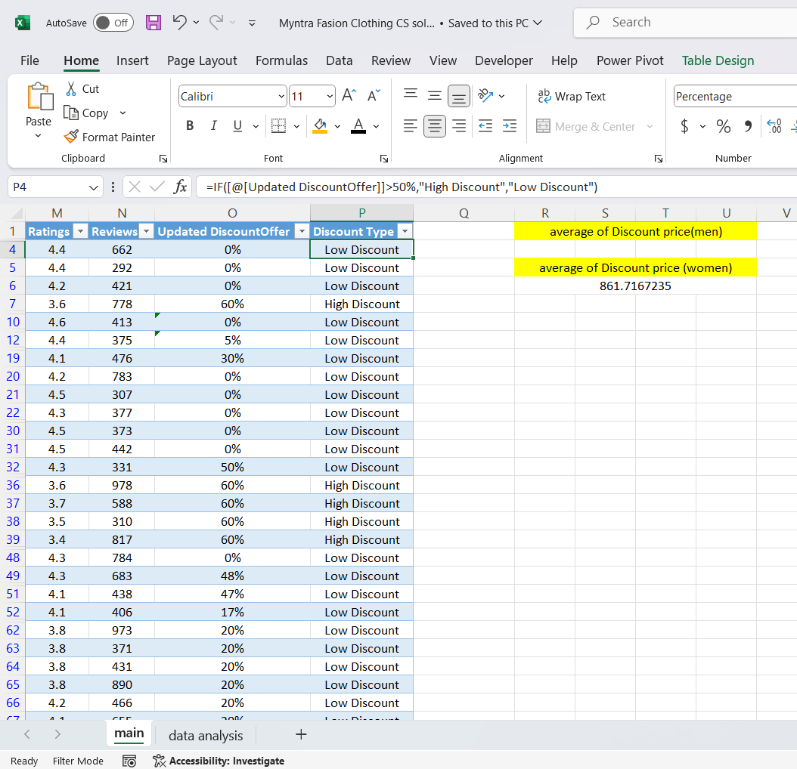
B4. Create a new column to label the products as "High Discount" if the discount offer is greater than 50% OFF, otherwise label them as "Low Discount."
Created a new column “Discount type” and applied IF condition.
Nb : The selection includes only the first 10,000 rows from the original document.

Slide 12
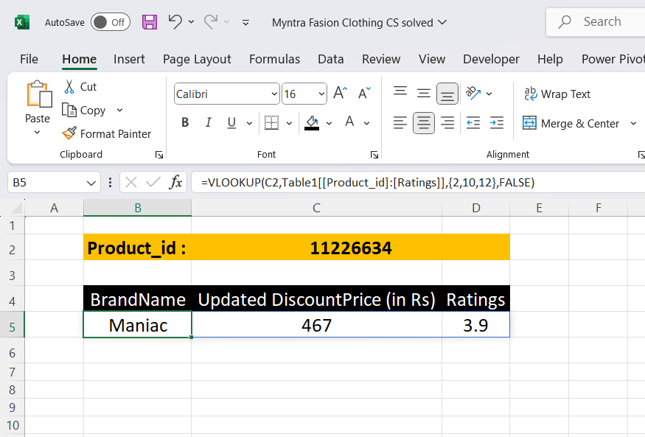
C. Data Retrieval and Lookup
C1. Use VLOOKUP/XLOOKUP to find the product brand, price, and rating of the product with Product_id "11226634".
Executed using vlookup in another sheet.
Nb : The selection includes only the first 10,000 rows from the original document.

Slide 13
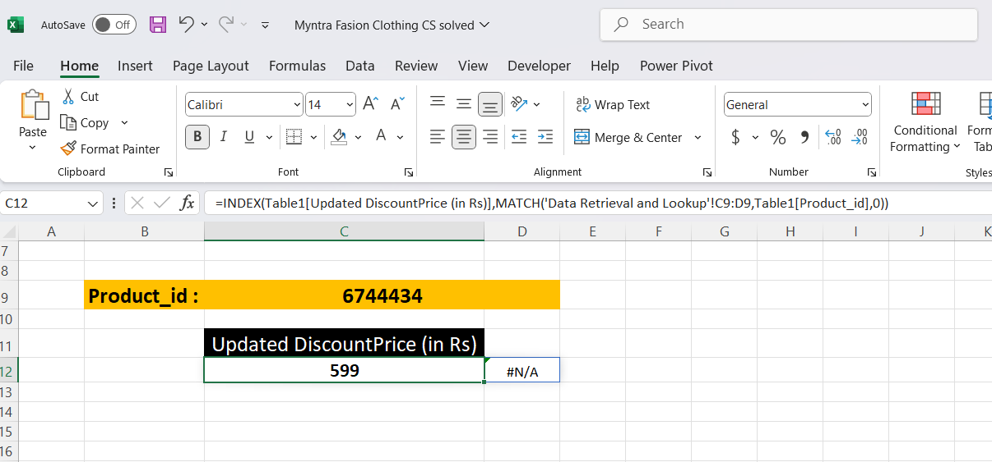
C2. Find the "Discount Price" for the product with the Product ID "6744434" using the INDEX and MATCH functions.
Executed using INDEX+MATCH in another sheet.
Nb : The selection includes only the first 10,000 rows from the original document.

Slide 14
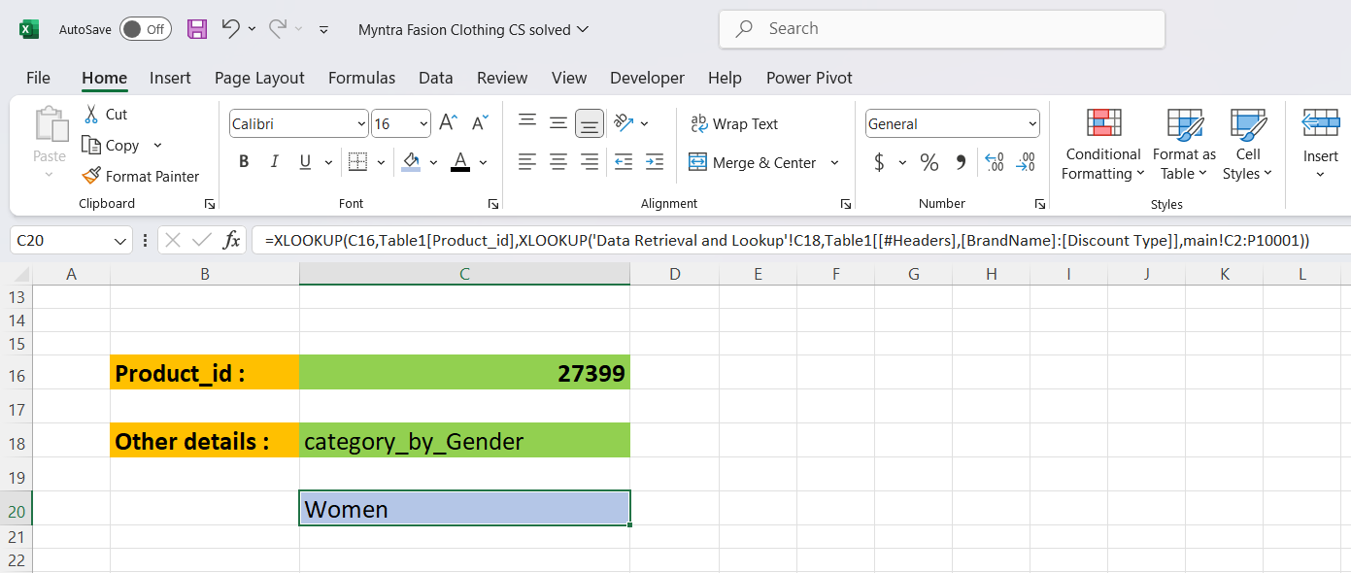
C3. Utilize nested xlookup to find any column’s detail of a product with it’s product id.
Data -> data validation -> List : form a list for product_id
Repeat the same for other details also
Perform nested xlookup
Nb : The selection includes only the first 10,000 rows from the original document.

Slide 15

Thank You

